Slide 1
Los Angeles Traffic Collision Data
Abdul Rafay
Presented by:
Los Angeles Traffic Collision Data

Slide 2
Why did we do it?
Why we decided to take on that topic?
To raise awareness about the frequency and severity of traffic collisions in Los Angeles.
To understand the causes and consequences of these collisions.
To explore ways to improve traffic safety in the city.
Los Angeles Traffic Collision Data

Slide 3
Data Collection
The data was collected by the Los Angeles Police Department (LAPD) and made publicly available.
We analyzed the data to identify trends and patterns. Here is the link to the data: https://data.lacity.org/A-Safe-City/LAPD-Traffic-Collision-Data-2010-to-Present/d5tf-ez2w.
Los Angeles Traffic Collision Data

Slide 4
What did we do?
How does it work?
● We created a presentation on Los Angeles traffic collision data.
● We used statistics and visual aids to illustrate the frequency and severity of traffic collisions in the city.
● We discussed the causes and consequences of traffic collisions and the need for continued efforts to improve traffic safety.
Los Angeles Traffic Collision Data

Slide 5
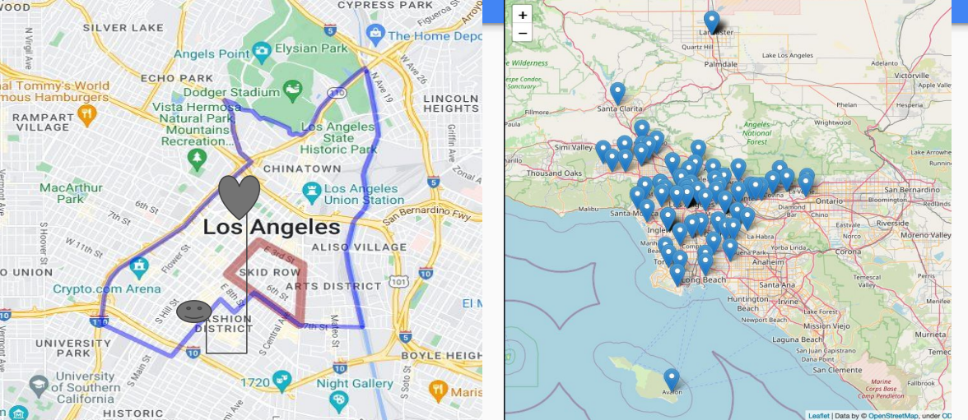
Project Demo
traffic safety app
Los Angeles Traffic Collision Data

Slide 6
There has been a significant decrease in the number of traffic collisions in Los Angeles in recent years, but there is still room for improvement.
Most traffic collisions in Los Angeles involve passenger cars, followed by pedestrians and bicycles.
The most common causes of traffic collisions in Los Angeles include speeding, distracted driving, and driving under the influence.
Hit-and-run collisions are a serious problem in the city, with a significant number of collisions involving a hit-and-run driver.
Certain areas of Los Angeles have higher rates of traffic collisions than others, indicating a need for targeted efforts to improve traffic safety in those areas.

Slide 7
What we learned?
What can be next?
Continued analysis of the data to identify new trends and patterns.
● Collaboration with local authorities and organizations to improve traffic safety.
● Raising awareness and educating the public about the importance of safe driving practices.
● Speeding, distracted driving, and driving under the influence are the primary causes of traffic collisions in Los Angeles.
● Pedestrians are at a higher risk of fatalities in traffic collisions.
● Hit-and-run collisions are a serious problem in the city.
Los Angeles Traffic Collision Data

Slide 8
Big thank you to our collaborators!
Los Angeles Traffic Collision Data

